Slide 1

Basic Details of the Team and Problem Statement
Ministry/Organization Name/Student Innovation:
PS Code: SIH 1363
Problem Statement Title: Enhancing quality education in rural areas
Team Name: ALPHA
Team Leader Name: Manas Rai Kaushik
Institute Code (AISHE): C-46112
Institute Name: ABES ENGINEERING COLLEGE
Theme Name: Smart Education

Slide 2
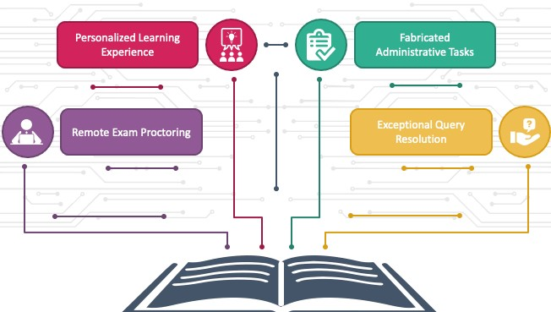
Idea/Approach Details
Describe your idea/Solution/Prototype here:
Idea: The proposed system, named “EduGO," aims to uplift education and socio-economic conditions in rural areas. It's a holistic approach to empower rural communities through education and access to resources.
Solution:
Digital Learning Platform:
Mentorship Program:
Skill Progress Monitoring:
Digital Literacy and Connectivity:
Employment Portal:
Research and Development Center:
Material Resources Access:
Describe your Technology stack here:
HTML (Hypertext Markup Language)
CSS (Cascading Style Sheets):
JavaScript:
Relational Databases: MySQL, PostgreSQL, Microsoft SQL Server, and SQLite for structured data storage.
NoSQL Databases: MongoDB, CouchDB, and Cassandra for handling unstructured or semi-structured data.

Slide 3
Idea/Approach Details
Describe your Use Cases here
Describe your Dependencies / Show stopper here
Basic Literacy and Numeracy Programs
Vocational Training and Skill Development
Health Education and Awareness
Environmental Education and Sustainability
Girls' Education and Gender Equality
Financial Literacy and Entrepreneurship
Teacher Training and Professional Development
Employment Opportunities and Career Guidance.Cultural Preservation and Heritage Education:
Preserve and promote local cultures and traditions through education.
Teach indigenous languages, traditional arts, and heritage conservation.
Community Development through Education
Community Engagement and Ownership:
Dependency: Active involvement and ownership of the local community in education programs are vital for their success.
Show-stopper: Lack of community buy-in, resistance to change, or cultural barriers can impede progress.
Access to Infrastructure and Resources:
Dependency: Adequate physical infrastructure, such as schools, classrooms, and learning materials, is necessary.
Show-stopper: Insufficient infrastructure, lack of resources, or poor maintenance can disrupt learning environments.
Access to Technology and Connectivity:
Dependency: In the digital age, access to technology and the internet is vital for modern education.
Show-stopper: Inadequate access to devices, unreliable internet connectivity, or lack of technical support can hinder digital learning initiatives.

Slide 4
Team Member Details
Team Leader Name: Manas Rai Kaushik
Branch (Btech/Mtech/PhD etc): Btech Stream (ECE, CSE etc): CSE DS Year (I,II,III,IV): III
Team Member 1 Name: Prince Chaurasiya
Branch (Btech/Mtech/PhD etc): Btech Stream (ECE, CSE etc): CSE DS Year (I,II,III,IV): III
Team Member 2 Name: Prince Mishra
Branch (Btech/Mtech/PhD etc): Btech Stream (ECE, CSE etc): CSE DS Year (I,II,III,IV): III
Team Member 3 Name : Priyanka Yadav
Branch (Btech/Mtech/PhD etc): Btech Stream (ECE, CSE etc): CSE DS Year (I,II,III,IV): III
Team Member 4 Name: Shalini Mishra
Branch (Btech/Mtech/PhD etc): Btech Stream (ECE, CSE etc): IT Year (I,II,III,IV): III
Team Member 5 Name: Riya Sharma
Branch (Btech/Mtech/PhD etc): Btech Stream (ECE, CSE etc): IT Year (I,II,III,IV): III
Team Mentor 1 Name: Deepak Aneja
Category (Academic/Industry): Academic Expertise (AI/ML/Blockchain etc): NIL Domain Experience (in years):
Team Mentor 2 Name: Yashi Bhardwaj
Category (Academic/Industry): Academic Expertise (AI/ML/Blockchain etc): NIL Domain Experience (in years):

